Slide 1



Consumer Electronics:
Key Updates on Chargeability, Accessibility & Removability
Juliana Kecerová
Senior Regulatory Compliance Specialist
Siddhant Shahane
Regulatory Compliance Specialist
Vish Karasani
Moderator
Product Marketing Manager
September 27, 2023
Notes:
Live 00.00 Hello everyone!
Welcome to today’s webinar on the Key Updates on Chargeability, Accessibility & Removability.
Thank you for joining us today.
My name is Vish Karasani, Product Marketing Manager at Compliance & Risks, moderating the webinar today.
We are joined by the wonderful Juliana Kecerová, and Siddhant Shahane
Juliana is a Senior Regulatory Compliance Specialist, with a focus on consumer electronics and water efficiency.
Also joining us for the webinar is Sid, Regulatory Compliance Specialist, Compliance & Risks
Sid is the Subject Matter Expert (SME) on Brexit-related product safety. Working in the European product safety market he takes absolute delight in knowing that his work contributes to placing better quality, safer and longer-lasting products on the global market.

Slide 2



Webinar Platform Tips
Q&A Session
Slides & Webinar Recording
Request a Demo
Notes:
Before we kick off, I would like to give some orientation about the webinar platform:
The webinar slides are available to your left side of the screen along with a few helpful links if you would like to explore and learn more about Compliance & Risks can help simplify and accelerate your compliance processes.
We want this webinar to be as engaging as possible so please send us any questions you may have and we aim to address them during the Q&A session at the end of the webinar.
If you would like to submit a question for the Q&A session, use the Ask a Question widget on the left side of your screen
We will also follow up with you directly for any questions we don’t get to answer during today’s session.
At any time, if you are interested in having a member of our team follow up with you, don’t hesitate to use the “Request a Demo” button at the bottom of your screen.
Last but not the least, the webinar recording will be sent to you within 24 hours.

Slide 3
About Compliance & Risks
Notes:
Before we kick off on the webinar, I would like to provide a background about Compliance & Risks for those who are joining this series for the first time.

Slide 4

Mission Statement
Ensure global companies have the tools & information to build safe, sustainable, products in a world full of change
Notes:
At Compliance and Risks, our mission is to help ensure global companies have the tools and information to build consumers safe, sustainable, products in a world full of change.

Slide 5















Trusted by the World’s Leading Brands
Notes:
We are the trusted market access technology provider for the world’s leading brands. We have spent two decades honing the digital tools, expertise and content you need to stay ahead of the dynamic regulatory landscape and prove your products’ compliance, protecting your brands and helping drive your growth.

Slide 6




87k+
195
20+
27
30
9.6k
Regulations
Countries
Industries
Languages
Global Network Partners
Expert Queries answered
Notes:
At Compliance & Risks, we have the world’s most comprehensive regulatory database with 87,000 regulations historically available in C2P Platform. With a global regulatory coverage and expertise across 20 plus industries, we understand that regulatory compliance doesn’t sleep.
Our Regulatory experts team is truly global with 27 languages collectively spoken across the team, and are fortified by our 30 knowledge partners.

Slide 7
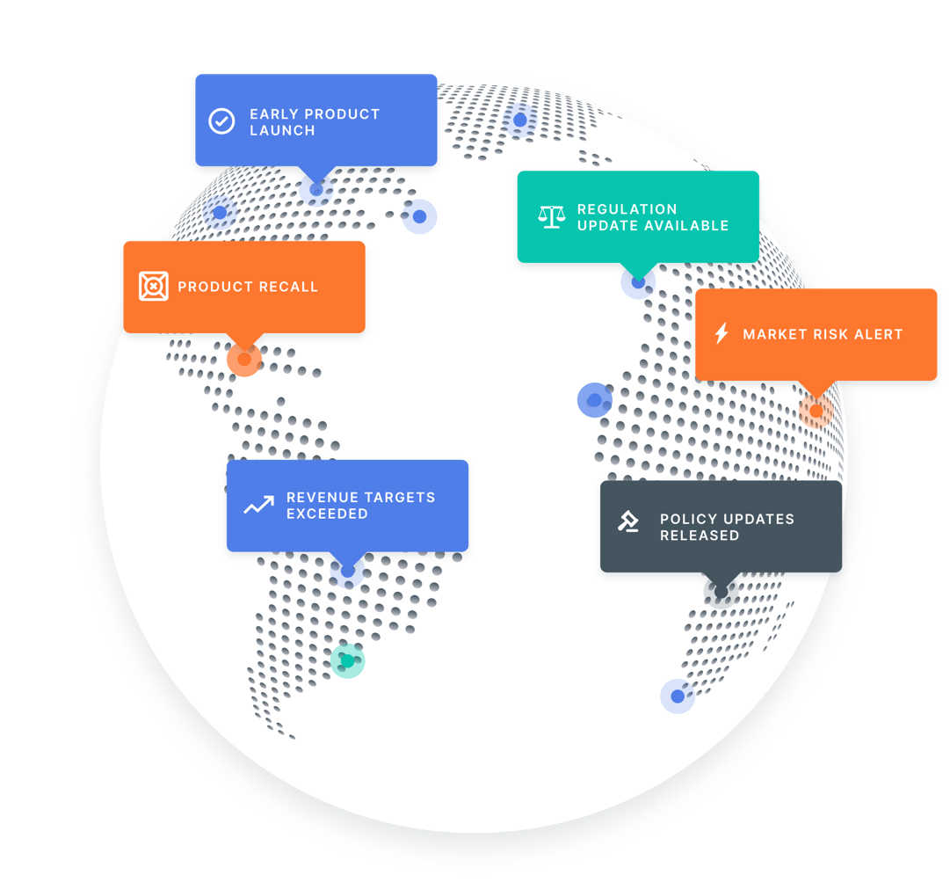
WHAT WE DO
Unlocking
Market Access
Keep on top of regulatory changes and their impact worldwide. Early warning alerts, impact probability, productivity workflow tools and so much more.
Notes:
C2P is the key to unlocking market access as new products can be designed and built with full confidence you’ve met all compliance obligations.
With that, I would like to hand it over to you Juliana.

Slide 8
Key Updates on Chargeability, Accessibility & Removability
Notes:
Thank you, Vish, hi everyone, thank you for joining us for today’s webinar related to consumer electronics. As you know, the world of consumer electronics is always changing, so today we’ll talk about the latest regulatory developments related to consumer electronics in the EU, UK, and few other countries, focusing on chargeability, accessibility and removability.

Slide 9
One Nation, One Charger Policy
Notes:
WE’LL BEGIN WITH THE EUROPEAN UNION and its ONE NATION, ONE CHARGER POLICY

Slide 10
EU Directive 2022/2380
“One charger to fit them all”
USB Type-C the common charging receptacle
Handheld mobile phones, tablets, digital cameras, headphones, headsets, handheld videogame consoles, portable speakers, e-readers, keyboards, mice, portable navigation systems, earbuds, laptops
Standard EN IEC 62680-1-3:2021
Information on specifications relating to charging capabilities and the compatible charging devices
Pictogram indicating whether or not a charging device is included with the radio equipment
Notes:
Published in December 2022, Directive 2022/2380 amending the EU Radio Directive also known as the RED Directive, introduced a common charger for various mobile devices.
Under the new rules, consumers will no longer need a different charger every time they purchase a new device, as they will be able to use one single charger for a whole range of small and medium-sized portable electronic devices.
Regardless of their manufacturer, all devices that are rechargeable via a wired cable, operating with a power delivery of up to 100 Watts, will have to be equipped with a USB Type-C port.
In relation to FAST CHARGING: All devices that support fast charging will now have the same charging speed, allowing users to charge their devices at the same speed with any compatible charger.
The aim of the Directive is to ensure consumer convenience, reduce environmental waste and avoid fragmentation of the market for charging devices.
It applies to the following categories or classes of radio equipment:
handheld mobile phones;
tablets;
digital cameras;
headphones;
headsets;
handheld videogame consoles;
portable speakers;
e-readers;
keyboards;
mice;
portable navigation systems;
earbuds;
laptops.
The USB Type-C technology, which is in global use, was adopted at international standardisation level and has been transposed into the European system under European Standard EN IEC 62680-1-3:2021
In so far as devices are capable of being recharged by means of wired charging, devices shall be equipped with the USB Type-C receptacle, as described in the said Standard and that receptacle shall remain accessible and operational at all times AND SHALL be capable of being charged with cables which comply with the Standard.
SO, IMPORTANT ASPECT IN RELATION TO THE DIRECTIVE IS THE POSSIBILITY FOR consumers and other end-users to acquire certain categories or classes of radio equipment without a charging device.
Where an economic operator offers to consumers and other end-users the possibility to acquire the radio equipment together with a charging device, they shall also offer the consumers the possibility of acquiring such equipment WITHOUT any charging device.

Slide 11

Charging Device is Included
If a charging device is included with the radio equipment.
Notes:
IN ADDITION, economic operators shall ensure that the information on whether or not a charging device is included with the radio equipment is displayed in a graphic form using a user-friendly and easily accessible pictogram when such radio equipment is made available to consumers and other end-users.

Slide 12
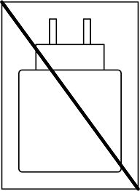
No Charging Device Included
If no charging device is included with the radio equipment
Notes:
The pictogram shall be printed on the packaging or affixed to the packaging as a sticker. When the radio equipment is made available to consumers and other end-users, the pictogram shall be displayed in a visible and legible manner and, in the case of distance selling, close to the price indication.

Slide 13
Compliance Timeline
Timeline for compliance with Directive (EU) 2022/2380
28 December 2024 | Handheld mobile phones, tablets, digital cameras, headphones, headsets, handheld video game consoles, portable speakers, e-readers, keyboards, mice, portable navigation systems, earbuds
28 April 2026 | Laptops
After December 28th, 2024, products already released before that date can be sold without a USB Type-C port. Devices introduced after that date must use a USB Type-C port for charging.
Notes:
THIS NEXT SLIDE is the TIMELINE for compliance with the Directive
28th of December 2024 – this is the compliance deadline for all handheld phones, tablets, digital cameras, headphones, headsets, handheld videogame consoles, portable speakers, e-readers, keyboards, mice, portable navigation systems, earbuds
28th of April 2026 - LAPTOPS
After December 28th, 2024, products already released before that date can be sold without a USB Type-C port. Devices introduced after that date must use a USB Type-C port for charging.

Slide 14
Meanwhile, elsewhere in the world
India - Standard IS/IEC 62680-1-3:2022
  by March 2025
Saudi Arabia - Decision No. 1/193/2023 on USB-C Common Charging Solution
  from 1 January 2025 - all mobile phones, digital cameras, e-readers, handheld video game consoles, headphones, earbuds, keyboards, mice, portable navigation systems, wireless routers, speakers and portable speakers
  from 1 April 2026 - laptops
Chile - Bill on the Standardising Common Chargers for Mobile Phones and other Similar Electronic Devices
  the same charging solution
Standardising Common Chargers for Mobile Phones and other Similar Electronic Devices
Notes:
WHAT ABOUT THE REST OF THE WORLD ??? It isn’t a whole lot happening… ;)
FEW countries have already taken inspiration from the EU Directive, or modelled their legislation on it.
For example, INDIA published Standard IS/IEC 62680-1-3:2022 which was notified by the Gazette Notification, published in December 2022, and IS ADAPTED from the international IEC standard.
The requirements should be adopted by MARCH 2025.
SAUDI ARABIA
Just few weeks ago, Saudi Arabia approved Decision No. 1/193/2023 to introduce a common charging solution (USB Type-C) for a broad range of radio and information technology equipment.
This Decision aims to improve user experience, prevent additional costs, offer high-quality charging and data transfer technology, and support sustainability by reducing the volume of e-waste. It is to be applied in two stages:
From 1 January 2025, all devices must comply with the new requirement, including mobile phones, tablets, digital cameras, e-readers, handheld video game consoles, headphones, earbuds, keyboards, mice, portable navigation systems, wireless routers, speakers and portable speakers.
From 1 April 2026, the unified charger requirements will extend to laptops.
The Decision also covers labelling requirements, including instructions related to charging devices and information on the minimum and maximum supported power.
AAAND to the next country…
CHILE was very brief in relation to the wording of Bill, which was published in December 2022.
The Bill contains one single Article which proposes that "all electronic devices, such as mobile phones, tablets, electronic books, digital cameras, game consoles, headphones and other similar devices, must have the same charging solution."

Slide 15
European Accessibility Act
Notes:
AND NOW, WE CAN MOVE onto to our next regulatory measure, which is the EUROPEAN ACCESSIBILITY ACT

Slide 16
The European Accessibility Act (EAA)
Directive 2019/882
accessibility requirements for product and services
  consumer terminal equipment with interactive computing capability, used for electronic communications services/for audiovisual media services
  consumer general purpose computer hardware systems and operating systems for those hardware systems
  self-service terminals
    automated teller machines
    ticketing machines
    check-in machines
    — interactive self-service terminals providing information, excluding terminals installed as integrated parts of vehicles, aircrafts, ships or rolling stock
  e-readers
Notes:
WHAT IS EAA? We’re talking about Directive (EU) 2019/882 of the European Parliament and of the Council of 17 April 2019 on the accessibility requirements for products and services.
Compared with other parts of the world, accessibility of Europe's private sector (which means: companies) is not yet regulated. Directive 2019/882 is a first big step to change that.
THE Directive standardises regulations on the accessibility of products and services, and forces providers to develop and provide their services and products with Inclusive Design in mind.
The purpose of this Directive is to contribute to the proper functioning of the internal market by approximating laws, regulations and administrative provisions of the Member States as regards accessibility requirements for certain products and services by, in particular, eliminating and preventing barriers to the free movement of certain accessible products and services arising from divergent accessibility requirements in the Member States. This would increase the availability of accessible products and services in the internal market and improve the accessibility of relevant information.
Demand for accessible products and services is high and the number of persons with disabilities is projected to increase significantly. An environment where products and services are more accessible allows for a more inclusive society and facilitates independent living for persons with disabilities.
This Directive applies to the following products placed on the market after 28 June 2025:
(a) consumer general purpose computer hardware systems and operating systems for those hardware systems;
(b) the following self-service terminals:
(i) payment terminals;
(ii) the following self-service terminals dedicated to the provision of services covered by this Directive:
— automated teller machines;
— ticketing machines;
— check-in machines;
— interactive self-service terminals providing information, excluding terminals installed as integrated parts of vehicles, aircrafts, ships or rolling stock;
(c) consumer terminal equipment with interactive computing capability, used for electronic communications services;
(d) consumer terminal equipment with interactive computing capability, used for accessing audiovisual media services;
and
(e) e-readers....

Slide 17
Obligations of Manufacturers
Product design in accordance with the applicable accessibility requirements
Technical documentation
Carry out conformity assessment procedure
Draw up an EU declaration of conformity and affix the CE marking
Keep the technical documentation and the EU declaration of conformity for five years
Products bear a type, batch or serial number or other element allowing their identification
Indicate the name, registered trade name or registered trade mark and the address at which they can be contacted on the product
Instructions and safety information in an easily understandable language
Notes:
1. When placing their products on the market, manufacturers shall ensure that the products have been designed and manufactured in accordance with the applicable accessibility requirements of this Directive.
2. Manufacturers shall draw up the technical documentation and carry out the conformity assessment procedure or have it carried out. Where compliance of a product with the applicable accessibility requirements has been demonstrated by that procedure, manufacturers shall draw up an EU declaration of conformity and affix the CE marking.
3. Manufacturers shall keep the technical documentation and the EU declaration of conformity for five years after the product has been placed on the market.
Products shall bear a type, batch or serial number or other element allowing their identification
Manufacturers shall indicate the name, registered trade name or registered trade mark and the address at which they can be contacted on the product
Instructions and safety information must be in an easily understandable language

Slide 18
General Accessibility Requirements
The information on the use of the product on the product itself (labelling, instructions and warning)
  made available via more than one sensory channel
  presented in an understandable way
  presented to users in ways they can perceive
  presented in fonts of adequate size and suitable shape, taking into account foreseeable conditions for use
Notes:
IN TERMS OF GENERAL ACCESSIBILITY REQUIREMENTS
Products must be designed and produced in such a way as to maximise their foreseeable use by persons with disabilities and shall be accompanied where possible IN or ON the product by accessible information on their functioning and on their accessibility features.
(a) the information on the use of the product provided on the product itself (labelling, instructions and warning) shall be:
o made available via more than one sensory channel;
o presented in an understandable way;
o presented to users in ways they can perceive;
o presented in fonts of adequate size and suitable shape, taking into account foreseeable conditions of use, and using sufficient contrast, as well as adjustable spacing between letters, lines and paragraphs;

Slide 19
The Instructions for use of a product, where not provided on the product itself (website)
  all above +
  content - made available in text formats that can be used for generating alternative assistive formats
  be accompanied by an alternative presentation of any non-textual content
  include a description of the user interface of the product (handling, control and feedback input and output)
  include a description of the functionality of the product
  include a description of the software and hardware interfacing of the product with assistive devices
Notes:
The instructions for use of a product, where NOT provided on the product itself but made available through the use of the product or through other means such as a website, including the accessibility functions of the product, how to activate them and their interoperability with assistive solutions shall be publicly available when the product is placed on the market and shall be, besides everything that was mentioned in the previous slide:
(i) be made available via more than one sensory channel;
(ii) be presented in an understandable way;
(iii) be presented to users in ways they can perceive;
(iv) be presented in fonts of adequate size and suitable shape, taking into account foreseeable conditions of use and using sufficient contrast, as well as adjustable spacing between letters, lines and paragraphs;
(v) with regard to content, be made available in text formats that can be used for generating alternative assistive formats to be presented in different ways and via more than one sensory channel;
(vi) shall be accompanied by an alternative presentation of any non-textual content;
(vii) include a description of the user interface of the product (handling, control and feedback, input and output) which is provided in accordance with point 2; the description shall indicate for each of the points in point 2 whether the product provides those features;
(viii) include a description of the functionality of the product which is provided by functions aiming to address the needs of persons with disabilities in accordance with point 2; the description shall indicate for each of the points in point 2 whether the product provides those features;
(ix) include a description of the software and hardware interfacing of the product with assistive devices; the description shall include a list of those assistive devices which have been tested together with the product

Slide 20
Compliance Timeline
2019
2022
2025
Entry into Force
Transposition by Member States
Compliance Deadline
27 July 2019
28 June 2022
28 June 2025
Notes:
Accessibility requirements apply to products placed on the market after June 28, 2025.

Slide 21
Battery Regulation - Removable and Replaceable Batteries
Notes:
LASTLY, I’LL JUST BRIEFLY MENTION ONE ASPECT FROM THE NEW EU BATTERY REGULATION.
SINCE IT IS A VERY COMPLEX PIECE of LEGISLATION, WHICH HAS BEEN IN MAKING FOR 3 YEARS OR even more, I’M ONLY FOCUSING ON A TINY ASPECT of this Regulation …… AND IT’S IN RELATION TO REMOVABLE AND REPLACEABLE BATTERIES

Slide 22
Battery Regulation - Removable and Replaceable Batteries
Battery Regulation (EU) 2023/1542
18 February 2027 - portable batteries incorporated into appliances should be removable and replaceable by the end-users
can be removed from a product with the use of commercially available tools
without requiring the use of specialised tools
instructions and safety information on the use, removal and replacement of the batteries
SLI batteries and electric vehicle batteries that are incorporated in motor vehicles should be removable and replaceable by independent professionals
Notes:
The Regulation provides that by 2027 portable batteries incorporated into appliances should be removable and replaceable by the end-user, leaving sufficient time for operators to adapt the design of their products to this requirement. This is an important provision for consumers.
Any natural or legal person that places on the market products incorporating portable batteries shall ensure that those batteries are readily removable and replaceable by the end-user at any time during the lifetime of the product.
That obligation shall only apply to entire batteries and not to individual cells or other parts included in such batteries.
A portable battery shall be considered readily removable by the end-user where it can be removed from a product with the use of commercially available tools, without requiring the use of specialised tools, unless provided free of charge with the product, without proprietary tools, thermal energy, or solvents to disassemble the product.
Any natural or legal person that places on the market products incorporating portable batteries shall ensure that those products are accompanied with instructions and safety information on the use, removal and replacement of the batteries. Those instructions and that safety information shall be made available permanently online, on a publicly available website, in an easily understandable way for end-users.
THAT’S ALL FROM ME AND NOW I’M LEAVING THE STAGE TO SID, who will talk about recent changes in relation to labelling in the UK. Thank you!

Slide 23
UK Labelling and proposed Voluntary E-labelling

Slide 24
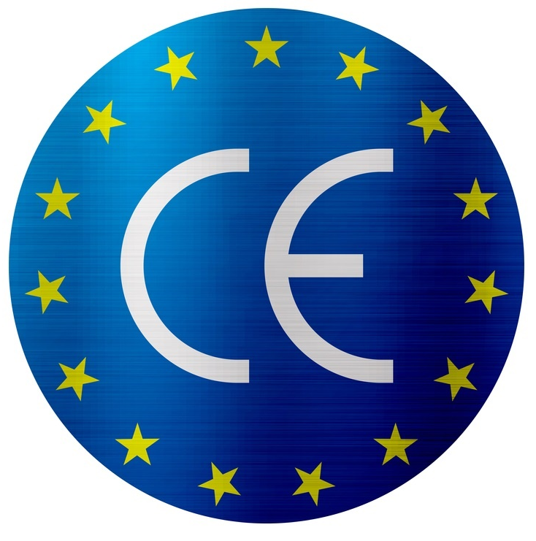

Product Safety Labelling in the UK
CE - Conformité Européenne
UKCA - UK Conformity Assessed
UKNI - For Northern Ireland
These markings apply to consumer electronics such as laptops, mobile phones, etc.
There are also specific rules for other products such as:
medical devices
construction products
products requiring ecodesign and energy labelling, etc.

Slide 25
August 2023 Announcement
Department for Business and Trade announces indefinite CE mark recognition beyond December 2024 deadline.
The government intends to extend recognition of the CE marking for placing most goods on the market in Great Britain, indefinitely, beyond December 2024. If you have already started using the UKCA mark, you can continue to do so.
The extension will provide businesses with flexibility and choice to use either the UKCA or CE approach to sell products in Great Britain.
This comes as part of a wider package of smarter regulations designed to ease business burdens and help grow the economy by cutting barriers and red tape. Following extensive engagement with industry, British firms will be able to continue the use of CE marking alongside UKCA.

Slide 26
This update applies to the 18 regulations that fall under the Department for Business and Trade (DBT). These are:
toys
pyrotechnics
recreational craft and personal watercraft
simple pressure vessels
electromagnetic compatibility
non-automatic weighing instruments
measuring instruments
measuring container bottles
lifts
radio equipment
pressure equipment
personal protective equipment (PPE)
gas appliances
machinery
equipment for use outdoors
aerosols
low voltage electrical equipment
Atex
There are different rules for medical devices, construction products, cableways, transportable pressure equipment, unmanned aircraft systems, rail products, marine equipment and ecodesign.

Slide 27
Voluntary E-labelling Consultation - August 2023
Adoption of optional electronic labelling or ‘e-labelling’, whereby manufacturers could, if they wish, make certain marking and compliance information available digitally via a screen rather than physically accompanying or indelibly marked on the product.
Potential benefits-
reduce waste;
relieving industry burdens and costs, and;
allow information to be easily updated through the lifetime of the product.

Slide 28
Exclusions to voluntary E-labelling
Limiting the proposal to devices with integrated screens or products designed for use with a screen.
Any information required by product safety legislation which is not a conformity marking or manufacturer's details, for example a warning of a choking hazard for a toy, would still need to be provided physically with the product as an indelible marking or on paper, as required, even where the device has an e-label accessible on the device.
With the growth of the internet of things some products that may have a screen or can only be used with a screen might be considered to have functions that are too high-risk to rely on electronic labelling alone. For example, this might include some products with industrial uses.

Slide 29















Google Alerts
Events
& Trade Shows
Trying to keep on top of it all...
Industry
& Associations
Mailing List, Webinar & Whitepaper
Paperwork
& File Sharing
Consulting
& Legal Services
Notes:
We know that managing product compliance is a daunting task
Weather you have 1, 100, or 1000+ products, what we have heard consistently is that it is difficult to stay on top of all the moving parts
From sources of information, to file sharing, to collaboration…you and your teams are often overwhelmed

Slide 30
A Smarter Way to Manage Product Compliance
Holistic Market Access Solutions

Slide 31




Demonstrating Compliance
Unlock Market Access, by …
For what is required
Driven by Global Regulations & Standards
Notes:
In order to do this, you need to demonstrate compliance, for what is required, driven by global regulations & standards - as well as your own company requirements
This is often a daunting task when you think about all of your products and all of the regions that your products are being sold in
You need a better way to manage the work required to accomplish your goals…

Slide 32
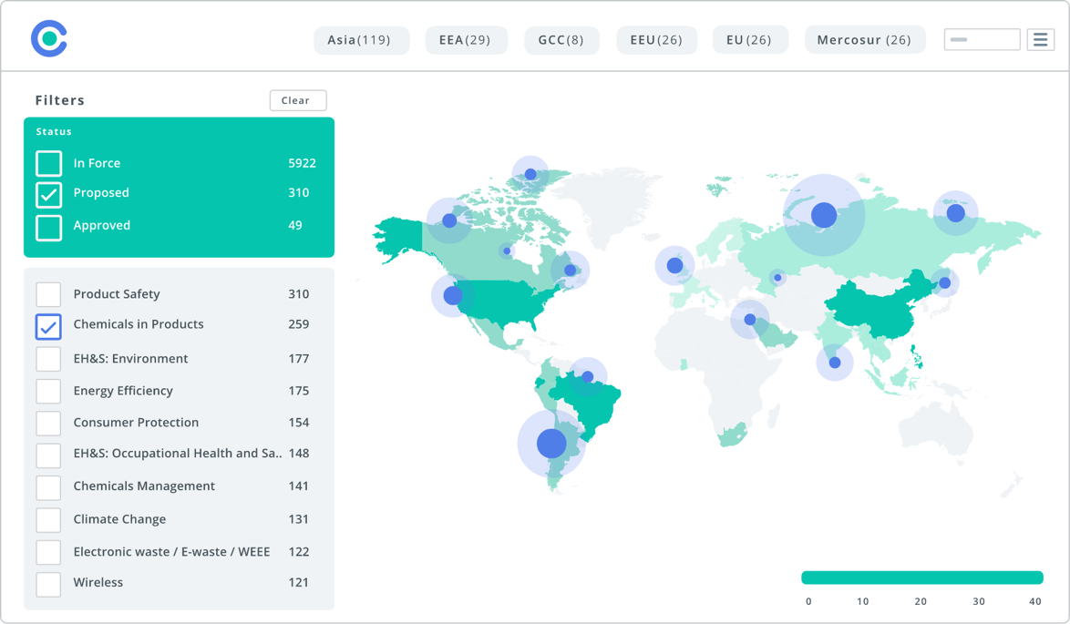
TECHNOLOGY - C2P
C2P
The Key to Unlocking Market Access
Enterprise grade technology
Cloud based platform
Access to regulatory coverage in 195 countries
Heatmaps with what’s hot & where
Intelligent search
AI powered probability analysis
Productivity tools to improve team collaboration
Notes:
That is where C2P comes in
C2P has been purpose built and is THE SMARTEST way to unlock market access
C2P is an enterprise grade, cloud based, SaaS technology platform that provides the foundational tools you need to holistically manage this process and related work

Slide 33
TECHNOLOGY - C2P
Manage everything in One Place…
Design, build, and collaborate on new products with confidence
Keep all compliance evidence up to date & live linked back to their Regulations, Standards & Requirements
Continually monitor regulatory changes & keep ahead of proposed changes before they happen
Integrate with other systems to enable streamlined business processes
Notes:
With C2P, our customers are able to design, build, and collaborate on new products with confidence
They are able to ensure their compliance evidence is up to date and linked back to regulations, standards and requirements
And they have peace of mind that regulations are monitored by our team of subject matter experts
So that they are proactive about how they achieve, maintain and expand market access for their products globally

Slide 34





TECHNOLOGY - C2P
Tailored to meet your needs…
SERVICES ACCELERATORS
Comprehensive capabilities that enable enterprise-wide management of regulations, standards, requirements and evidence
CONTENT ACCELERATORS
Add-on packages to accelerate market access through:
  Use-case specific solutions
  Global regulatory content
  Professional services
SOLUTIONS
C2P PLATFORM
Notes:
With C2P - the platform is tailored to meet your needs and grows with your business
It provides you all of the foundational building blocks to manage regulations, standards, requirements and evidence across your business
We have Product Compliance & ESG Solutions to help accelerate your Market Access journey.
You can also add additional regulatory content accelerators that provide the regulations and standards, or even predefined requirements
As well as services that help from training that enables you to get the most out of C2P to integrations that help connect C2P with the other systems that you have within your organization
C2P helps augment the existing tools in your organization and enables them to work smarter
All to help you accelerate market access for your products, globally

Slide 35
Q&A
Notes:
Question 1: Some of the consequences of the UKCA no longer being mandatory are not yet entirely clear to us. Is an EU conformity declaration enough? What will be the value of UKCA on our products?
Question 2: Is there any indication that the US will adopt the USB Type C as well?
Question 3: Is there any exception from the requirement that portable batteries must be removable and replaceable by end users?

Slide 36
Thank you!
Juliana Kecerová
Senior Regulatory Compliance Specialist
Siddhant Shahane
Regulatory Compliance Specialist
Vish Karasani
Moderator
Product Marketing Manager

